Slide 1
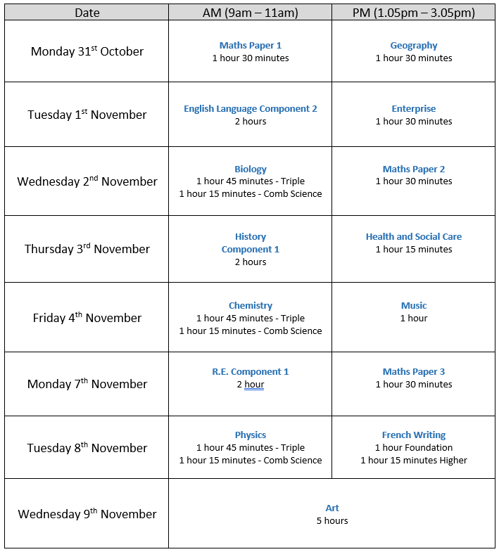
TOPICS TO REVISE
Year 11 Mock Exams

Slide 2
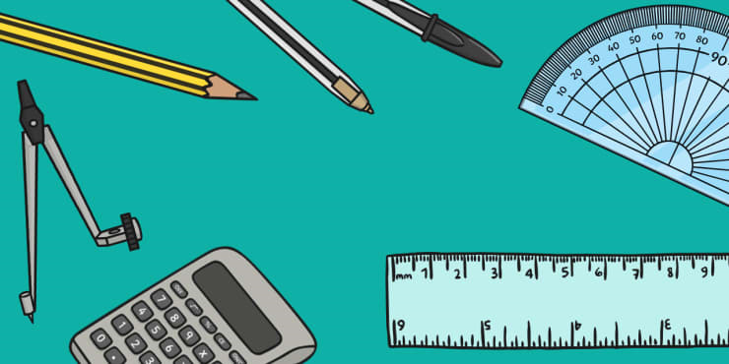
Maths: Foundation and Higher Tier
3 exam papers: each 1 hour 30 minutes
Topics to revise:
Data Handling and Statistics
Algebra
Geometry
Ratio, Proportion and Rates of Change
Number
Probability
Pupils will receive a more detailed list of topics to revise. If you would like a copy of this list, please email Mrs Mitchell (Head of Maths) cmitchell@friary.greywoodmst.co.uk

Slide 3

English Language
1 exam paper: 2 hours
Section A: Reading (1 hour)
Six comprehension questions based on two non-fictional extracts.
One extract will be from the 21st century, and the other will be from the 19th century.
Section B: Writing (1 hour)
Two transactional writing tasks. These could include writing a letter, article, guide, review, report or a speech.
The exam is 2 hours in total.
Mr Daniels sdaniels@friary.greywoodmst.co.uk

Slide 4

Science (combined)
3 exam papers: each 1 hour 15 minutes
Biology Paper 1 – Cell Biology; Organisation; Infection and Response; and Bioenergetics
Chemistry Paper 1 – Atomic Structure and the Periodic Table; Bonding,
Structure and the Properties of Matter; Quantitative Chemistry; Chemical Changes; and Energy Changes
Physics Paper 1 – Energy; Electricity, Particle Model of Matter; and Atomic Structure
Mr Brown
dbrown@friary.greywoodmst.co.uk

Slide 5

Separate Sciences: Biology, Chemistry, Physics
3 exam papers: each 1 hour 45 minutes
Biology Paper 1
Cell Biology; Organisation; Infection and Response; and Bioenergetics
Chemistry Paper 1
Atomic Structure and the Periodic Table; Bonding, Structure and the Properties of Matter; Quantitative Chemistry; Chemical Changes; and Energy Changes
Physics Paper 1
Energy; Electricity, Particle Model of Matter; and Atomic Structure
Mr Brown
dbrown@friary.greywoodmst.co.uk

Slide 6

French
3 exam papers (speaking mock Feb 2023 immediately prior to speaking exam March/April 2023)
Mrs Grigg
sgrigg@friary.greywoodmst.co.uk
Reading 25% Foundation 45 minutes, Higher 60 minutes
Writing 25% Foundation 1 hour 5 minutes, Higher 1 hour 20 minutes
Listening 25% Foundation 40 minutes, Higher 50 minutes
Theme 1 Identity and Culture :
You, family, friends, relationships, technology and social media, music, cinema, TV and going out ,food, sport, customs and festivals.
Theme 2 Areas of interest:
Home and local area, charity and volunteering, healthy living, holidays.
Theme 3 Study and Employment
My studies, life at school, education post 16, careers and ambitions.

Slide 7

Geography
Mrs Gisbourne
sgisbourne@friary.greywoodmst.co.uk
1 exam paper: 1 hour 30 minutes
Topics to revise:
Urban Issues and Challenges
The Challenge of Natural Hazards
Coastal Landscapes
Skills / Unfamiliar fieldwork

Slide 8

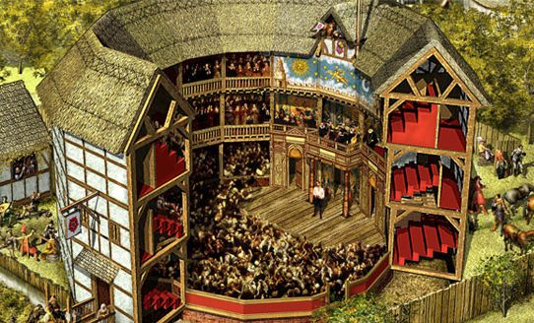
History
Mr Rivers-Boyce
lrivers-boyce@friary.greywoodmst.co.uk
1 exam paper: 2 hours
Topics to revise:
Entertainment and Leisure
Sport
Holidays
Music
Popular Entertainment
Children’s Entertainment
Cruelty in sport
Butlins
Germany:
Impact of WW1
Recovery of Weimar
End of Weimar
Consolidation of power
Hitler’s foreign policy
Nazi economic, social and racial policy.
Terror and persuasion

Slide 9



Religious Studies
Mrs Gabbitass
kgabbitass@friary.greywoodmst.co.uk
2 exam papers: 1 hour each
Christianity
Islam
Topics to revise:
Christianity
Beliefs - Nature of God, Creation, Jesus, Salvation, Afterlife
Practices – Worship, Sacraments, Pilgrimage, Celebrations, Christianity in Britain, Worldwide Church
Islam
Beliefs – Nature of Allah, Prophethood, Angels, Afterlife, Foundations of Faith
Practices – 5 Pillars of Islam, Jihad, Festivals, 10 Obligatory Acts

Slide 10

Health and Social Care
Ms Fallows
kfallows@friary.greywoodmst.co.uk
1 exam paper: 1 hour 15 minutes
Topics to revise:
Factors:
Cultural
Environmental
Lifestyle
Social
Economic
Physical
Life Event:
Bereavement
Divorce
Separation
Work – part time hours
Ill health/accident

Slide 11
Music
1 exam paper: 1 Hour (6 Questions in total)
Topic 1: Pop Music
Listening Questions from: Rock n Roll, Rock Anthems, Pop Ballads, Solo Artists
Topic 2: Rhythms of the World
Listening Questions from: Central and South America, Africa, Indian Subcontinent, Greek and Middle Eastern Folk Music
The exam is 1 hour in total.
Mr Hood
jhood@friary.greywoodmst.co.uk

Slide 12


Enterprise
Mrs Sherry
jsherry@friary.greywoodmst.co.uk
1 exam paper: 1 hour 30 minutes
Topics to revise:
Promotion:​
Face to face selling​
Message and Medium​
Different Methods of promotion (advantages and disadvantages)​
Business-to-business and Business-to-consumer ​
​
Finance:​
BOOKLET B1​
  Financial documents (purchase order, delivery note, credit note, invoice, receipt, Statement of account)​
  Maintaining accurate financial documents​
BOOKLET B2 - Methods of payment (including advantage and disadvantage)​
BOOKLET B3 & B4 ​
  Revenues (definition/examples)​
  Start-up costs/Running costs (definition/examples) ​
  Ways of improving gross and net profit​
BOOKLET B5 - Statement of comprehensive income

Slide 13
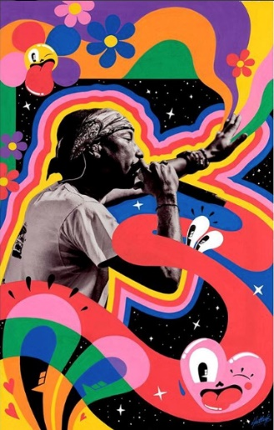
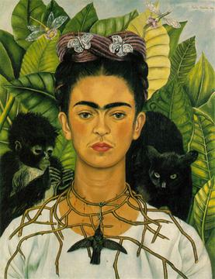
Art and Design: Unit 1 - AO4
Identity Project Final Outcome : 5 hours
Work created in this exam contributes to 25% of Unit 1
Preparation
Have portrait and background images to work from inspired from your analysis of Frida Kahlo, Hattie Stewart, and others.
Complete all your research, drawings and experiments to know what you prefer to do
Create a final piece plan
Draw your guidelines out before the exam
Your final piece will be in acrylic paint, watercolour or oil pastel
Mrs Brickett
Nbrickett@friary.greywoodmst.co.uk

