Slide 1

Student Finance

Slide 2

What to do!

Slide 3
Student Finance (SFE)
Student Finance England (SFE) provides financial support on behalf of the UK Government to students from England entering higher education in the UK.
The two main costs you’ll have while studying are Tuition Fees and living costs – Maintenance Loan.
There’s student finance available to help you with both.
Depending on your circumstances, you could also get extra financial help while you study.

Slide 4
Tuition Fees - £9,250
• You won’t have to pay any tuition fees up front.
• You can get a Tuition Fee Loan to cover the fee charged by your uni
or college.
• The amount you get doesn’t depend on your household income.
• SFE will pay the Tuition Fee Loan directly to your uni or college.
• You’ll have to start paying your Tuition Fee Loan back when you’ve
finished or left your course, but only if your income is over the repayment
threshold.

Slide 5
Maintenance Loan
You can get a Maintenance Loan to help with your living costs, such as rent.
All eligible students can get some maintenance support.
The amount you can get depends on where you live and study.
You can also apply for more based on your household income.
The Maintenance Loan is paid directly into your bank account at the start
of each term.
You’ll have to start paying your Maintenance Loan back when you’ve finished or left your course, but only if your income is over the repayment threshold.

Slide 6
Maintenance Loan
Maximum levels for 2021/2022
Up to £7,897
Parental Home
Live at home whilst you study
Up to £9,488
Living away from home
outside of London
Up to £12,382
Living away from home
Studying in London
Up to £10,866
Watch this for a full explanation:
https://www.youtube.com/watch?v=NbnqLZRjoAk
You spend a year of a UK course studying abroad

Slide 7
SFE – Student Finance Calculator
Use the calculator to assess approximately how much Maintenance Loan you maybe entitled to before completing the application form, or go straight on to the application process illustrated in the slides further on.
www.gov.uk/student-finance-calculator
The following slides walk you through the calculator process.

Slide 8
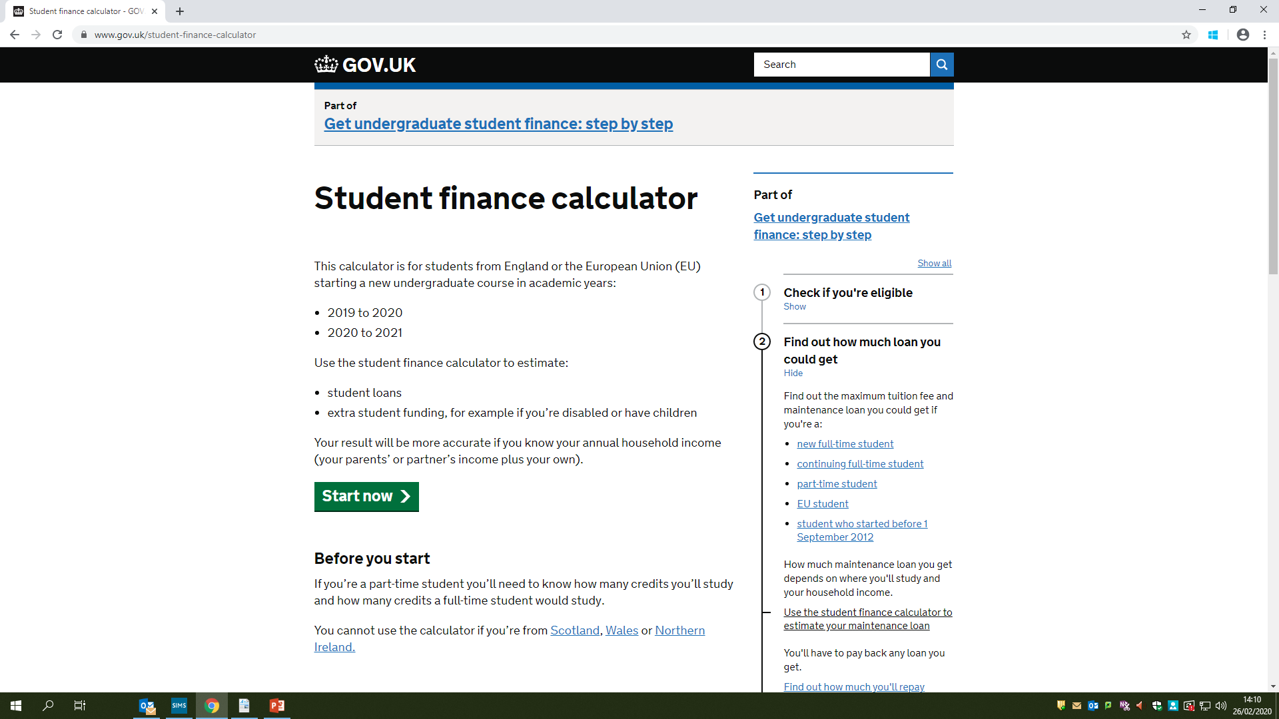
To use the calculator you do not need your personal information, just an estimate of your household income.
This is not the link into the actual application process.

Slide 9
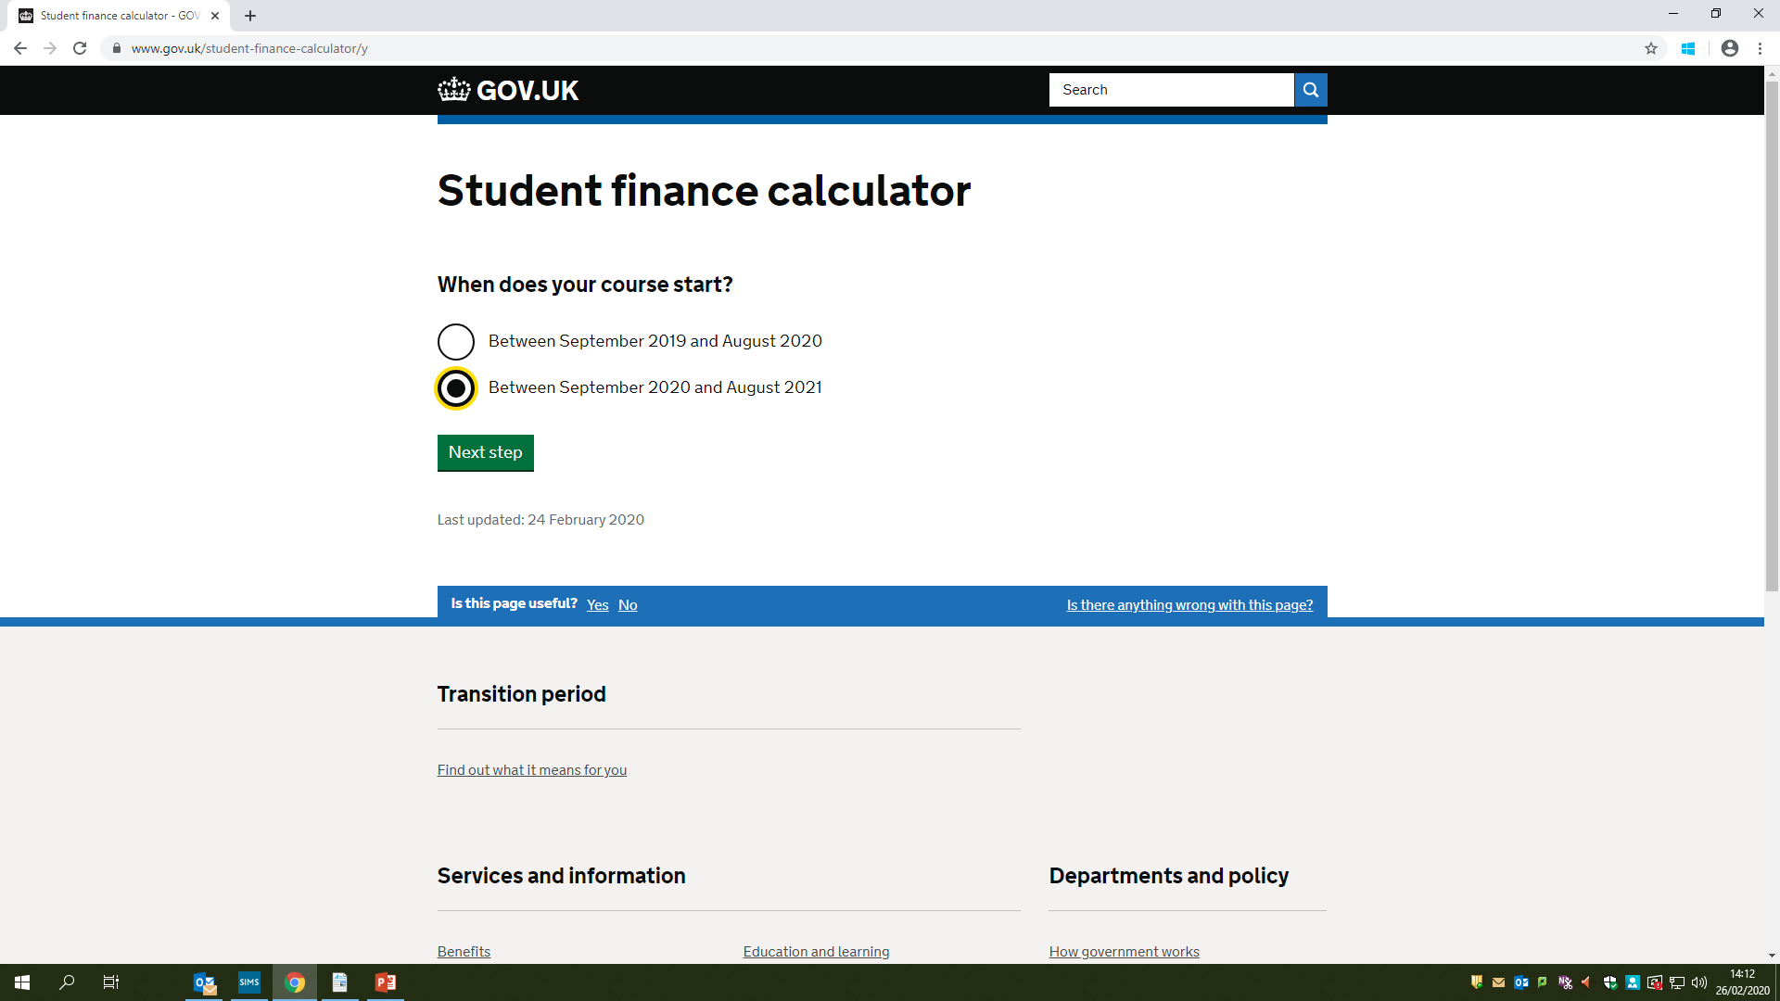
Between September 2021 and August 2022

Slide 10
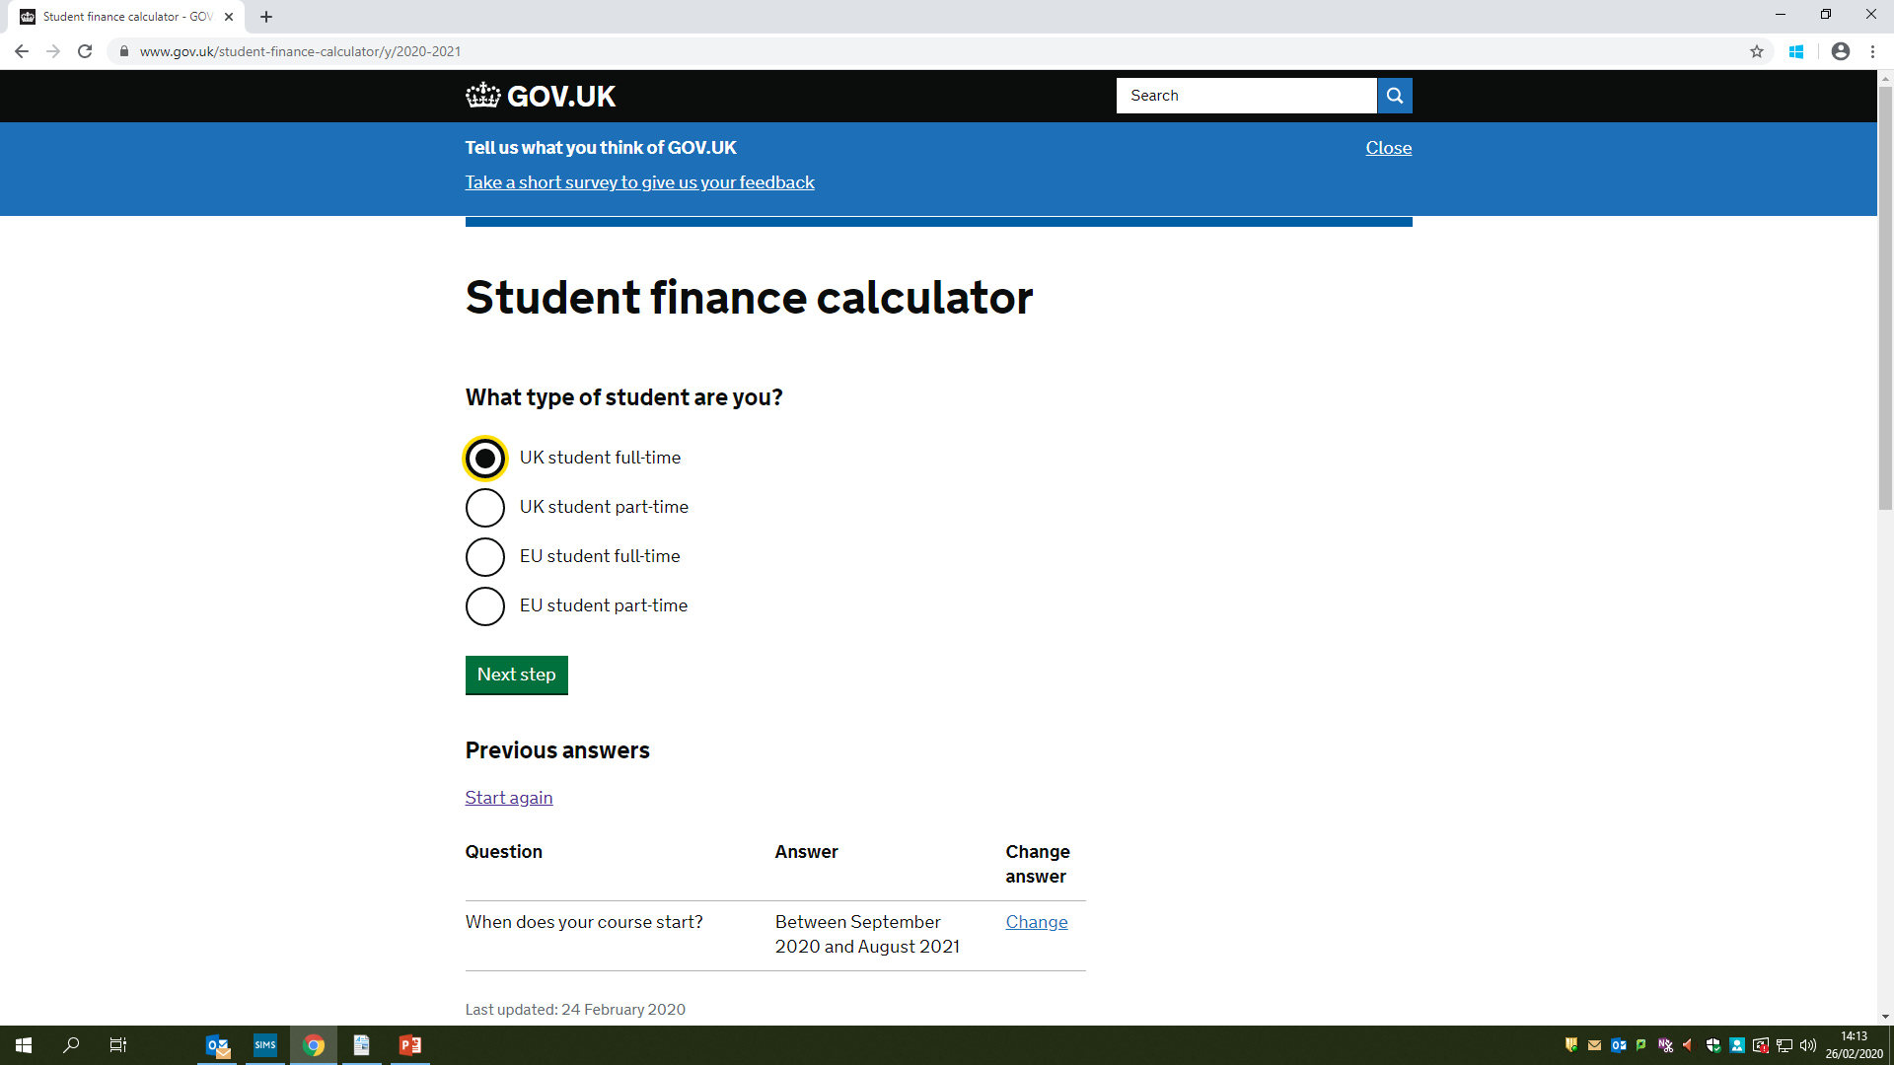
Between September 2021 and August 2022

Slide 11
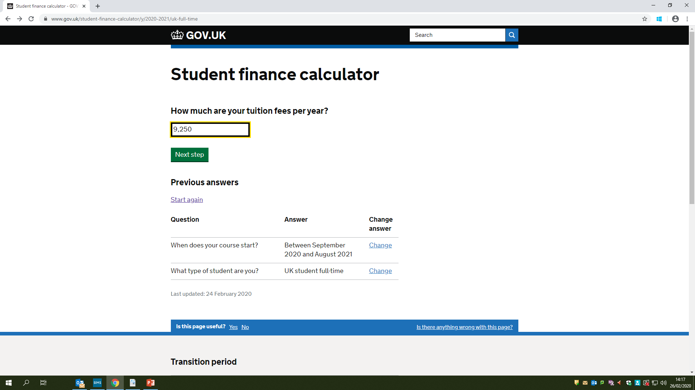
This hasn’t changed
Between September 2021 and August 2022

Slide 12
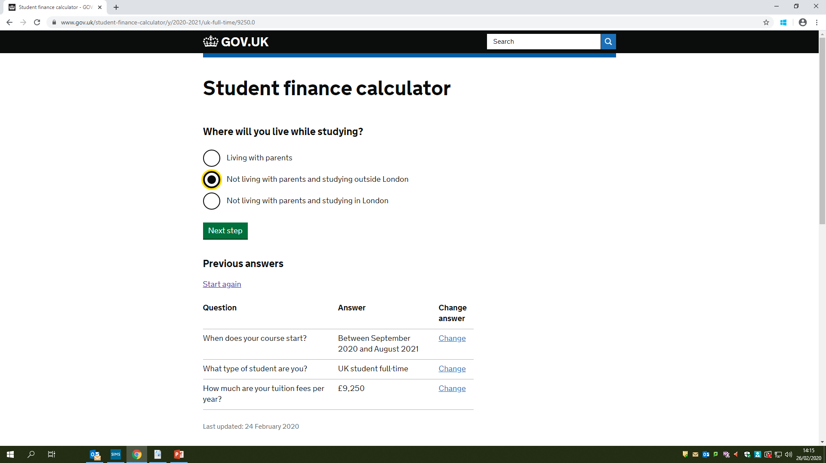
This is just an example, tick the box that relates to you.
Between September 2021 and August 2022

Slide 13
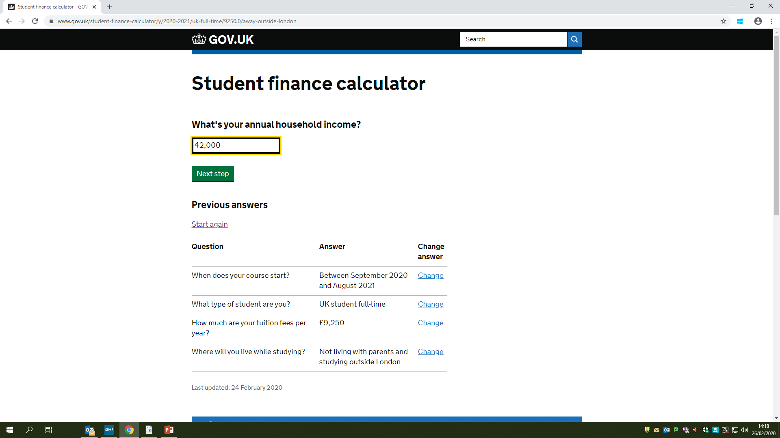
This is an example, just type in the amount that relates to your circumstances

Slide 14
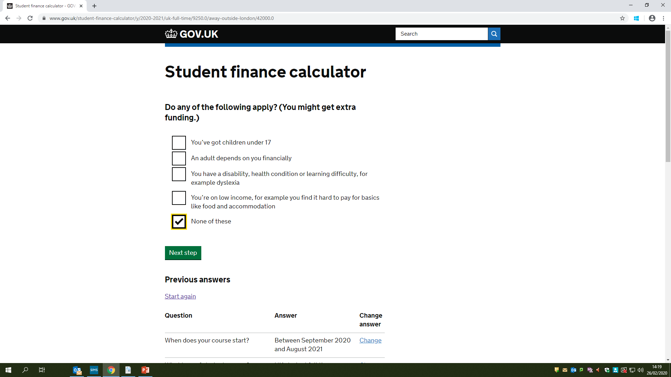
This is just an example, tick the box that relates to you

Slide 15
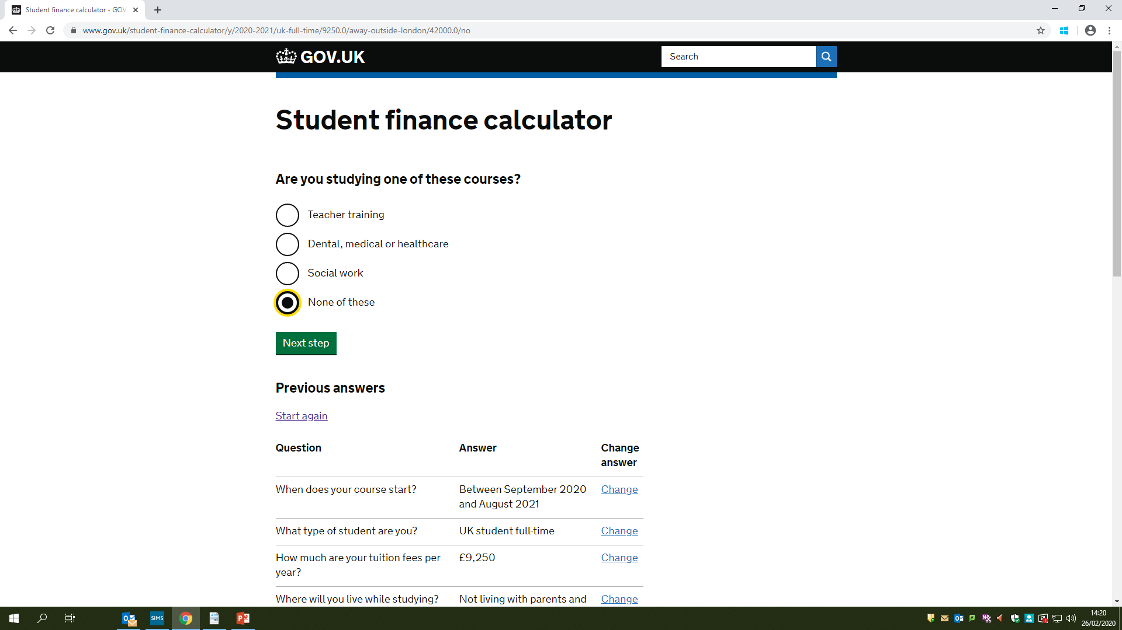
This is just an example, tick the box that relates to you
Between September 2021 and August 2022

Slide 16
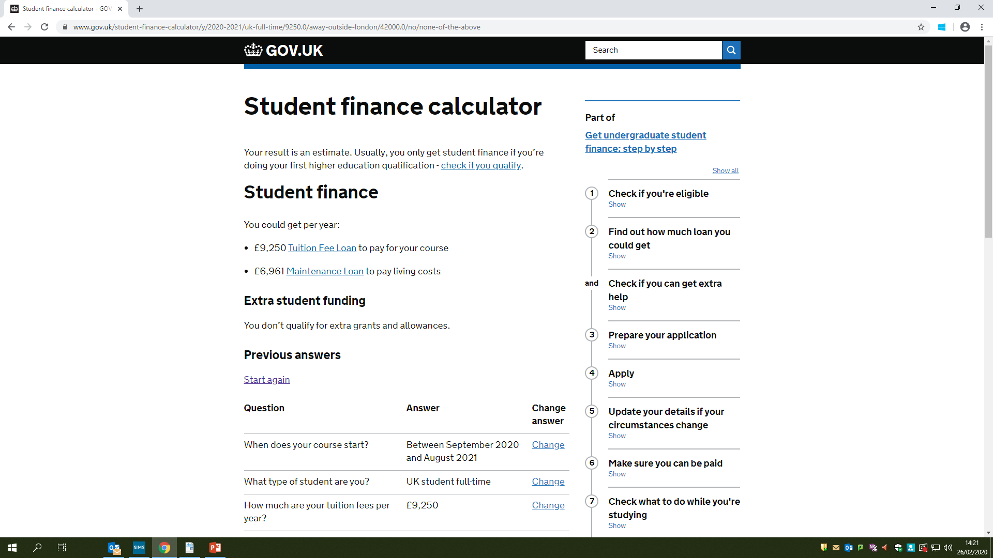
This will be paid straight to the uni

Slide 17

Completing your application.

Slide 18
What your account is all about…
Student finance login
Sign in or register for student finance online. You can:
view your statements and letters from Student Finance England
track an existing application
check when your payments are due
update some of your personal or application details
reset your password or find your customer reference number
apply for finance as a new or continuing student

Slide 19
Where to create an account
Google – “Student Finance England – Gov.uk”
Go to “Create an account” – follow instructions – see next slide
You must have the following at hand:
  Your National Insurance number
  Your course name and code
  Your parents/guardians email address(es)
Once you have completed your application with all the information required your parents/guardians will receive an email requesting they complete the remainder of the application regarding their income from a P60 dated 2019-2020 – type in exactly the amount, do not round off to nearest penny/pound

Slide 20
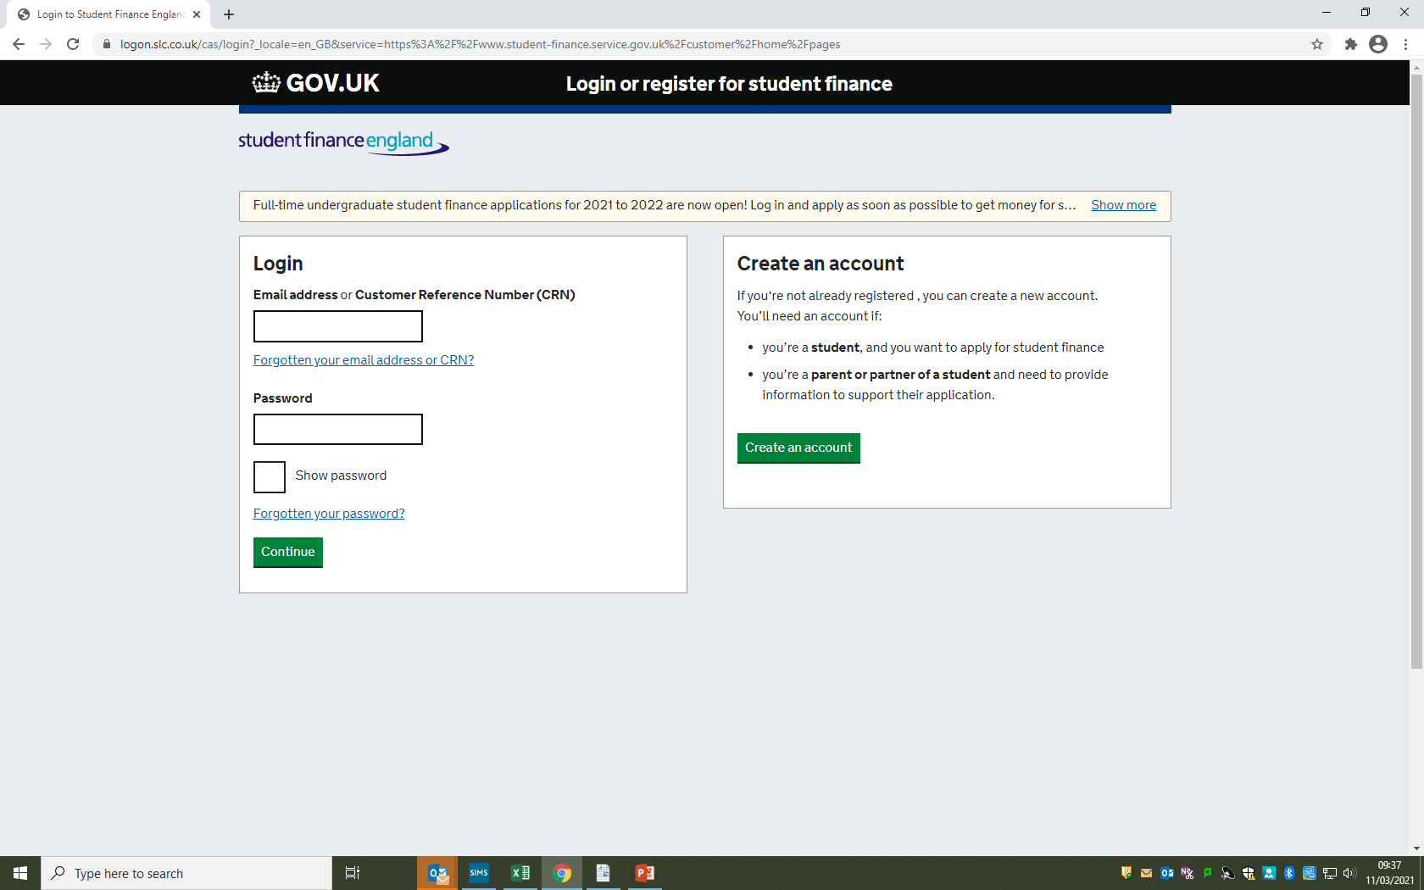
You and your parents/guardians will be required to apply every year. You only get finance for the term of your course plus one year (in case you re-start or change)

Slide 21
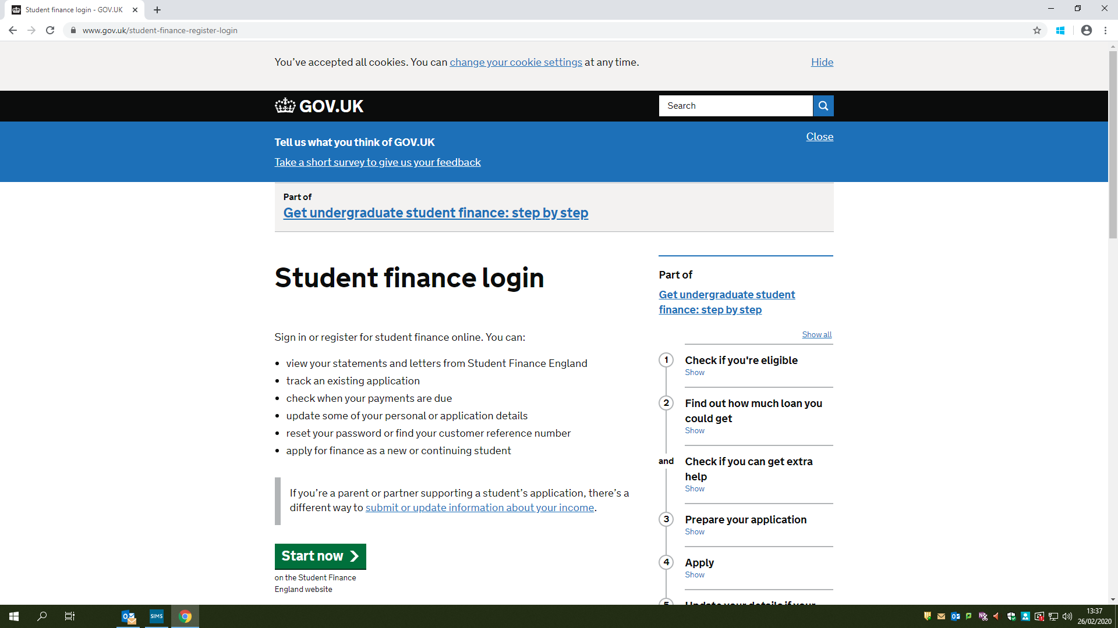
www.gov.uk/student-finance-register-login
Click

Slide 22
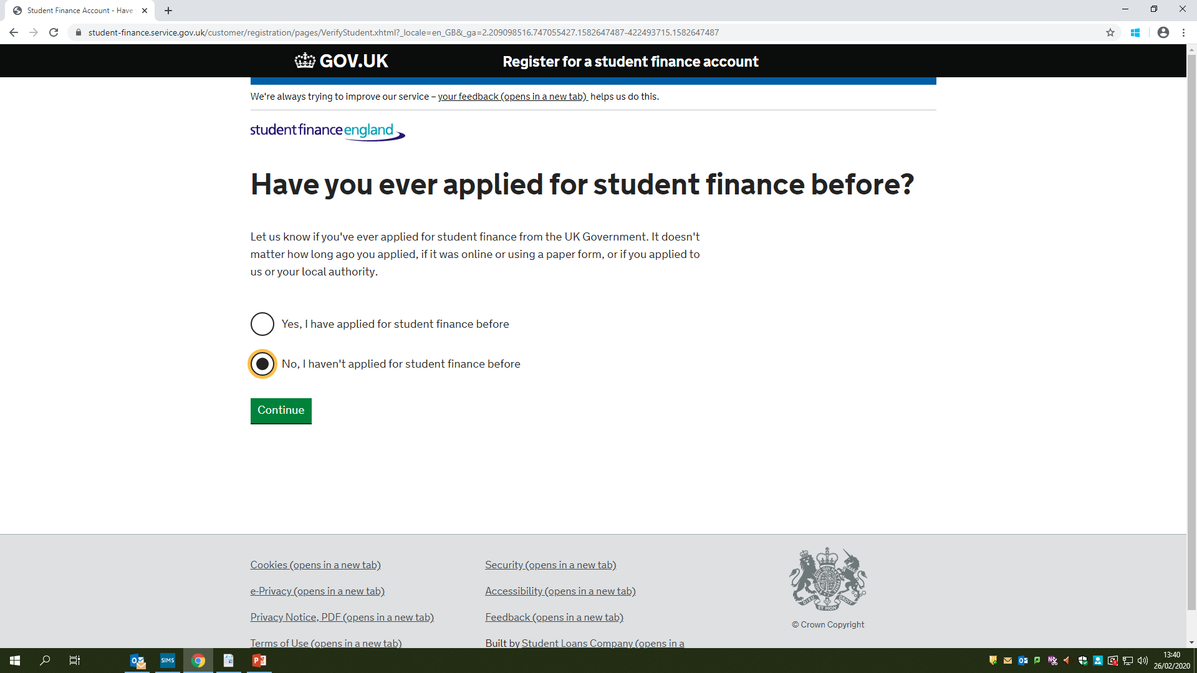

Slide 23
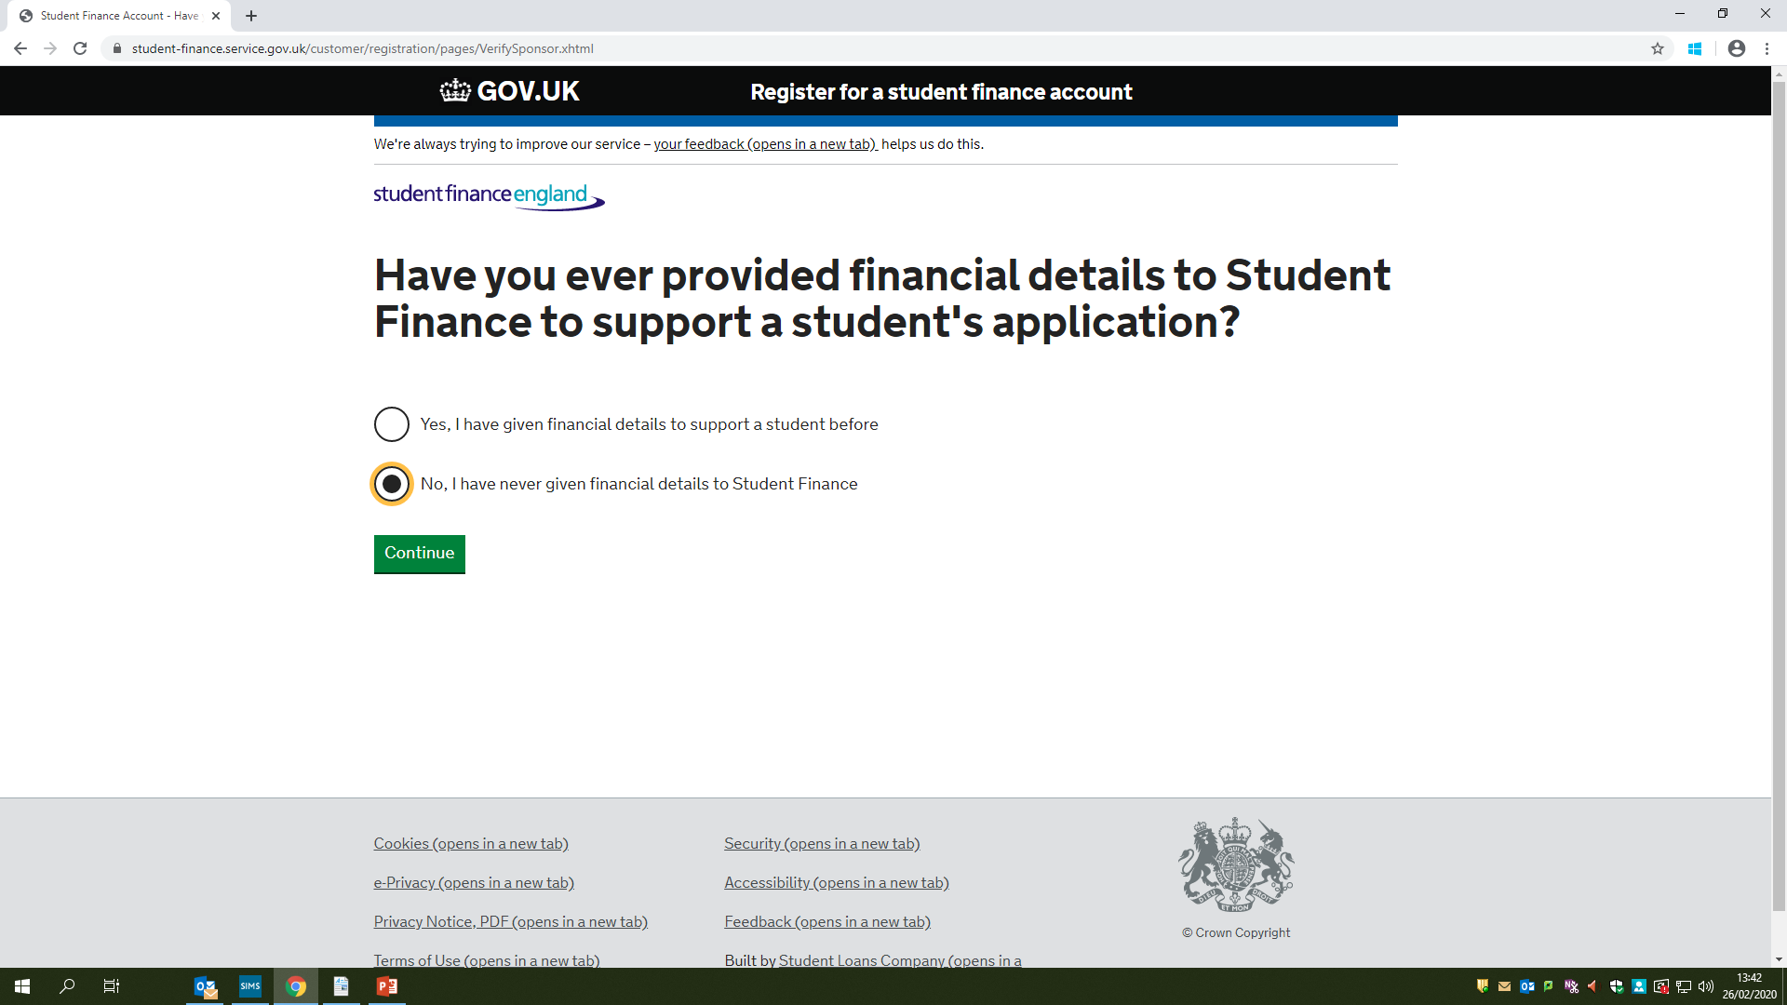

Slide 24
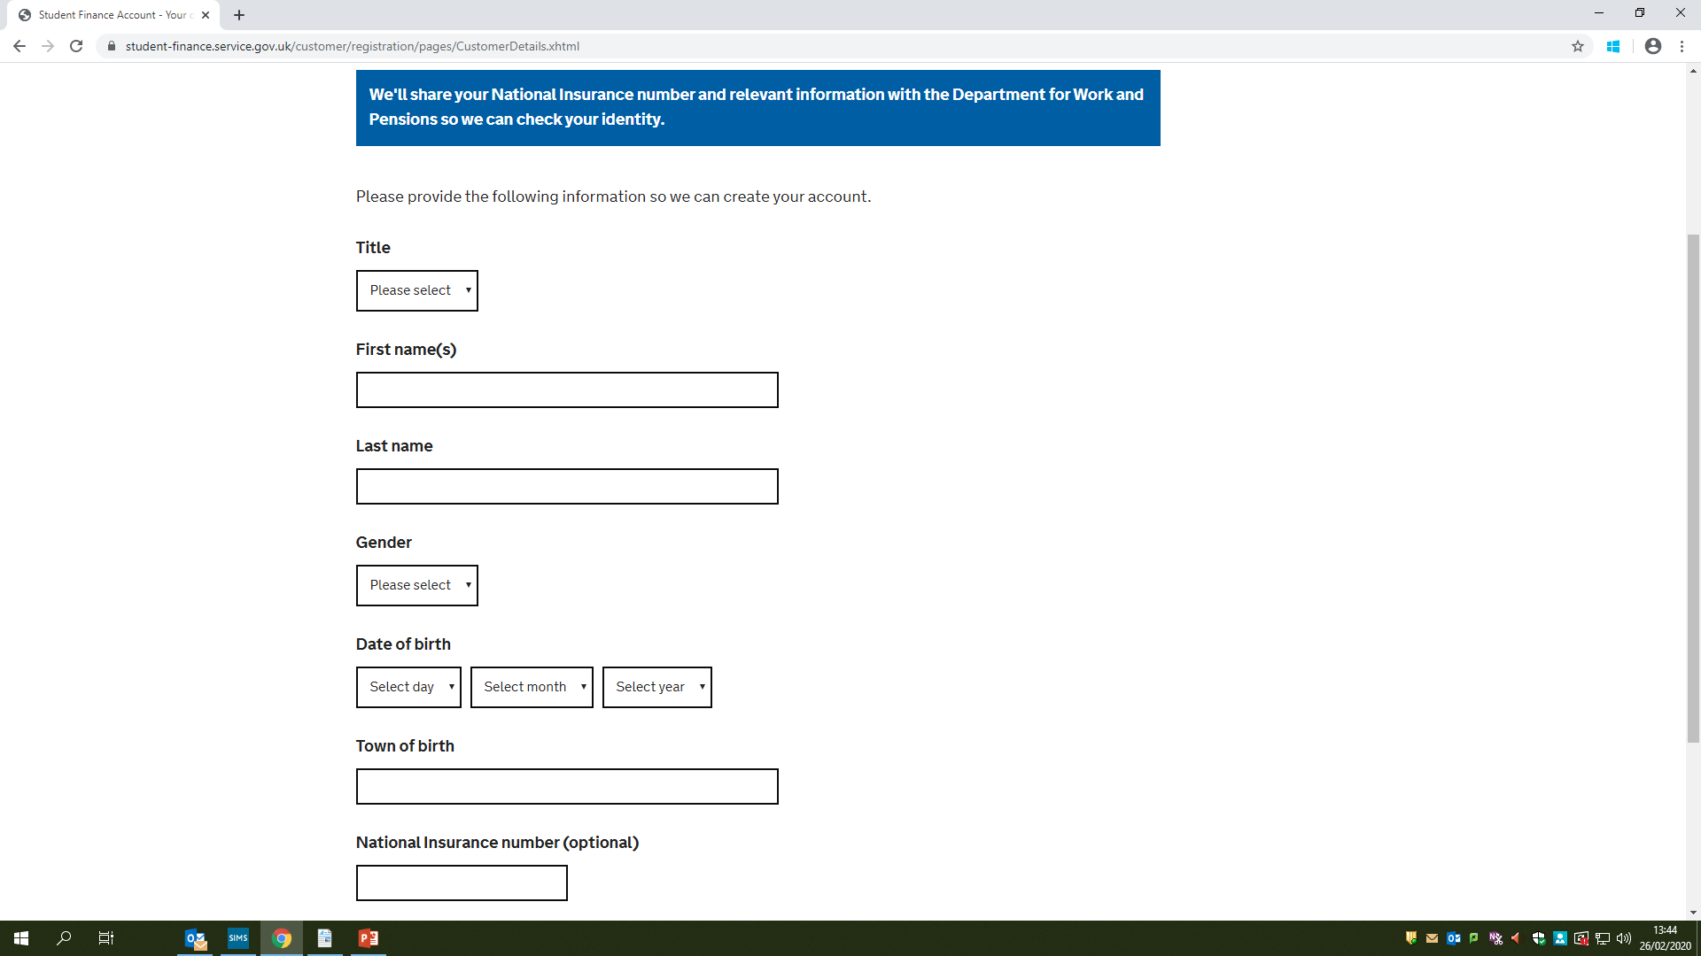

Slide 25
Once you have completed all fields, your parents/guardians should receive an email within 24hours for them to complete. The details will be checked with HMRC, therefore, if the incomes do not match, you will be required to provide evidence.
It normally takes up to 6 weeks to process.

Slide 26
How is the finance distributed?
Remember:
If you have applied for the student finance for the Tuition Fees, these will be paid directly to the university, once you have commenced your course.
If you have applied for the maintenance loan, this will be credited to your bank account in 3 termly payments:
One week after you commence your course
First week in January
First week in April
  First year - campus accommodation will have to be paid termly on or around receipt of payments.

Slide 27

Costs to expect
On the piece of paper, please list the costs you will need to budget for at University?

Slide 28
COSTS – in first year on campus
Rent
TV Licence (check with the uni – could be £50 a year per person – don’t need one if only streaming)
Wifi – check that it is included in your campus accommodation
Washing (approx. £2 a wash, £3 for dryer – normally you have to pay via an app, or tokens)
Travel
Course supplies (check with uni, especially if studying artistic subjects or science)
Food
Toiletries/household cleaning products
Phone
Hairdressers/barbers
Socialising
Clothes
Club memberships (gym, sports, uni Social events)
Special Occasions
Course Trips
Parking (majority of uni’s do not like you bringing your car whilst on campus, those that do, charge a yearly fee)
Deposit and first month’s rent for your second year – start looking asap, as all the good ones go first

Slide 29
Martin Lewis Talking About Student Finance
https://www.youtube.com/watch?v=mO_rAsMuAlM

