Slide 1

How to search for an apprenticeship

Slide 2
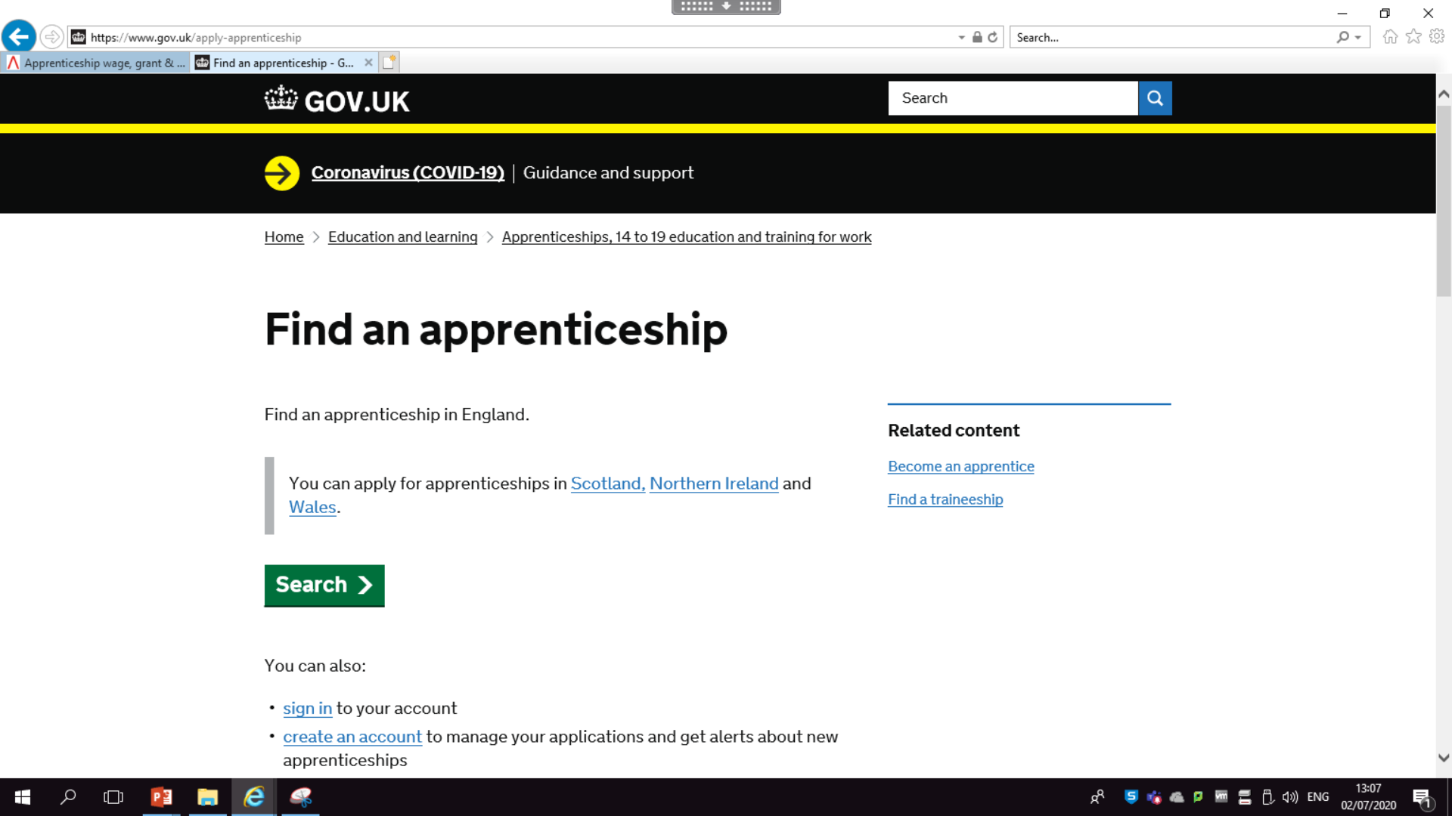
Search for an apprenticeship

Slide 3
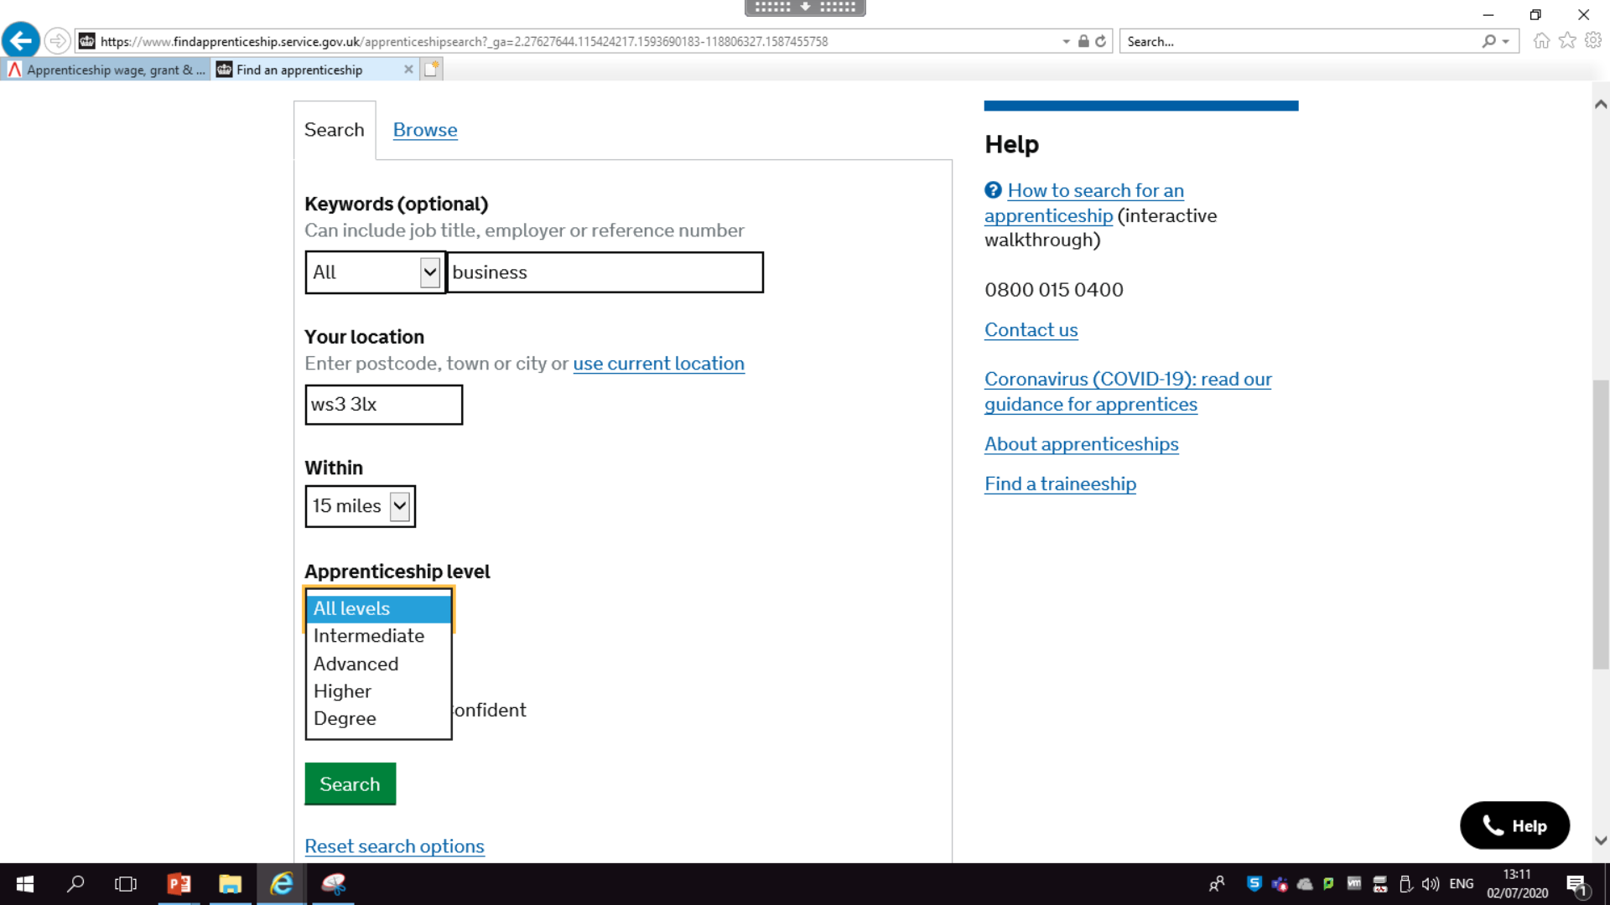
Don’t be too specific with search words, being more general will get more results
The further you are willing to travel the more results will come up
You can choose the level of apprenticeship

Slide 4
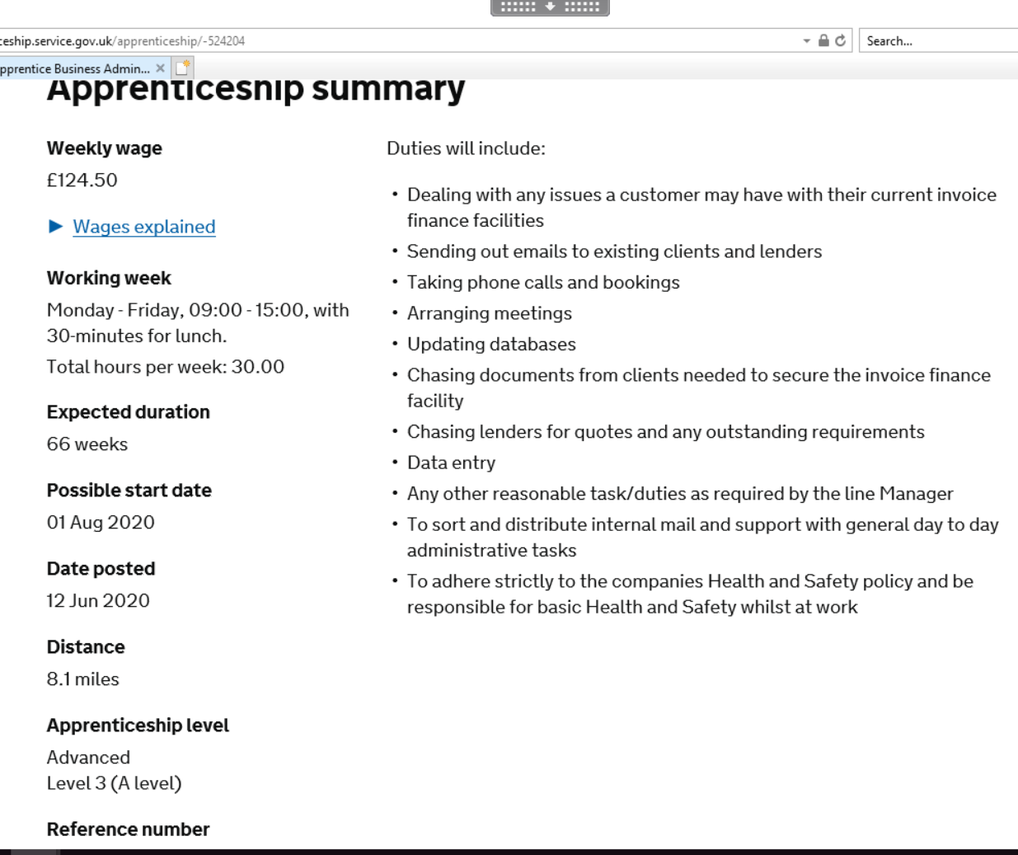
All the positions are laid out in the same way
Weekly wage at the top
Working hours
Level at the bottom

Slide 5
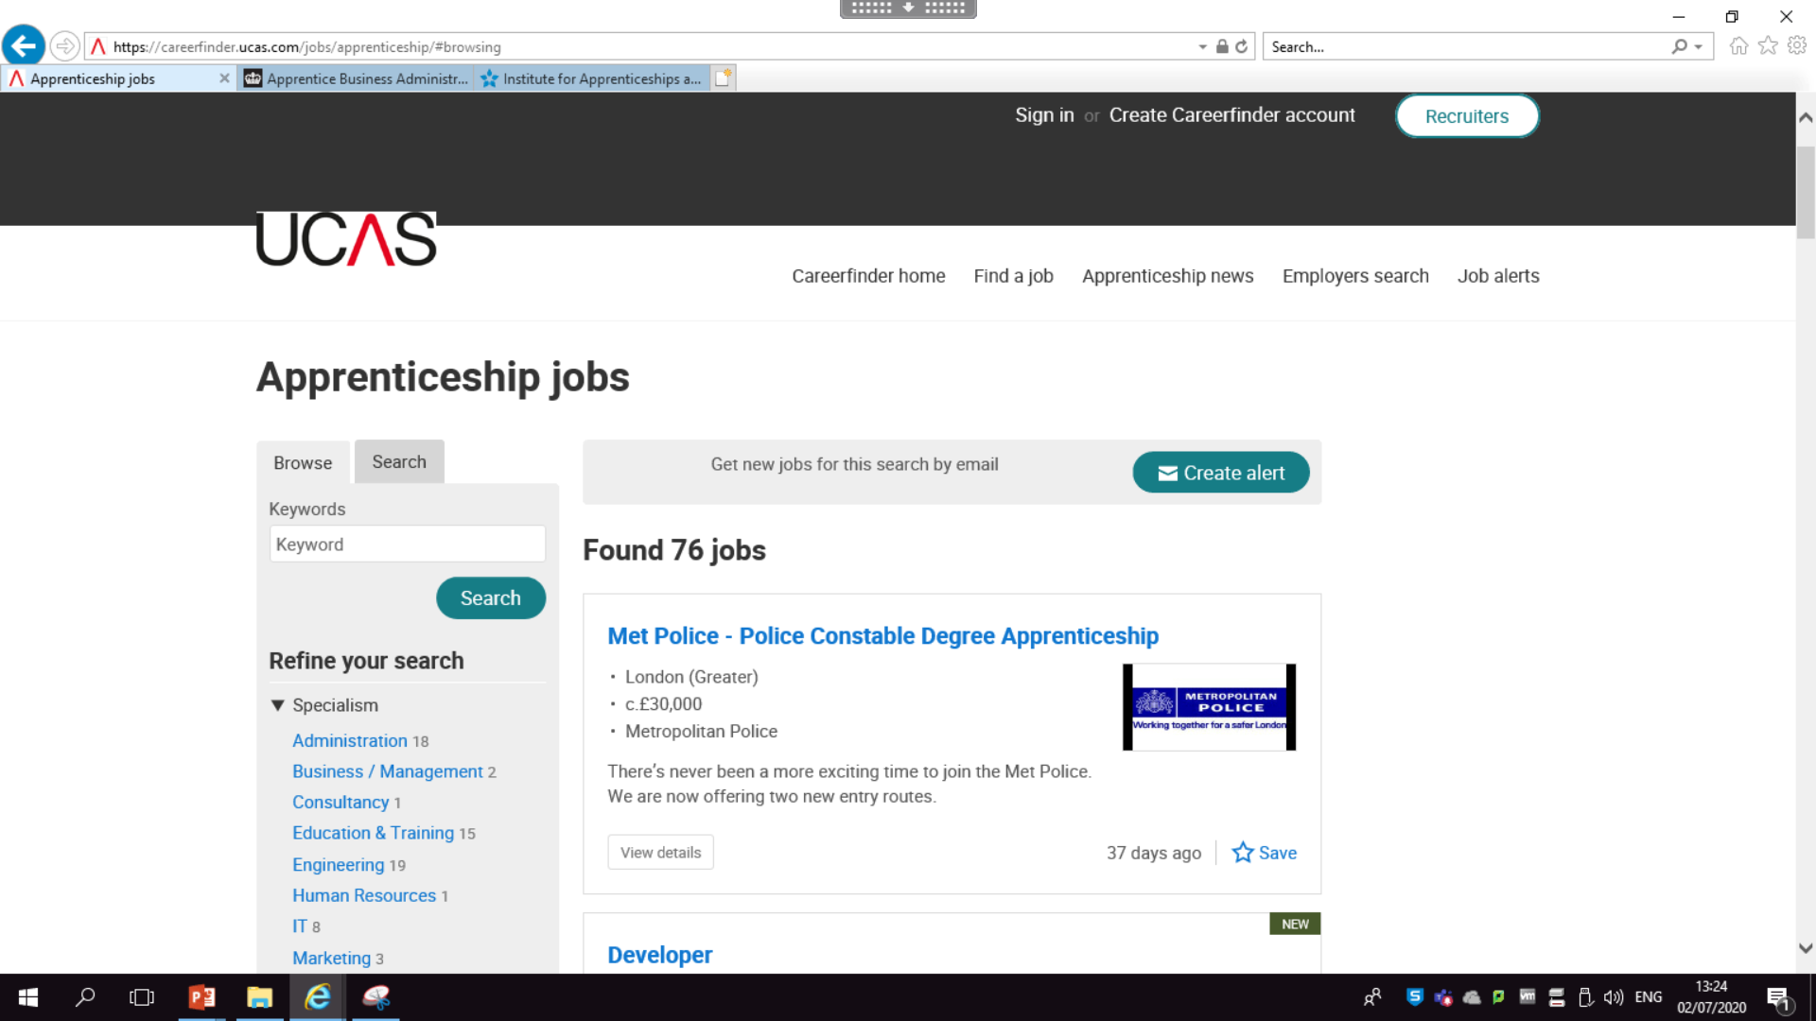
UCAS also have a good search tool particularly if you are looking at degree apprenticships
UCAS SEARCH TOOL

Slide 6
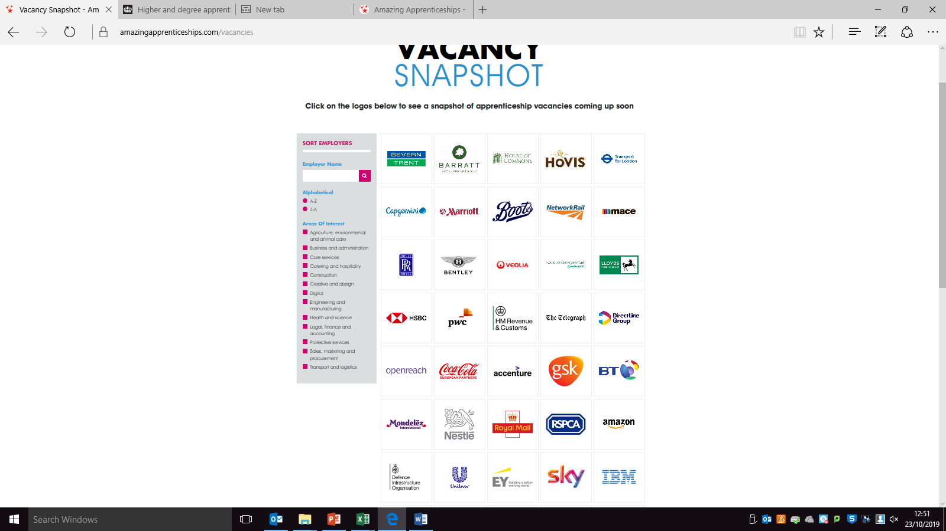

The Amazing Apprenticships site has a Vacancy Snapshot page which is particularly good for the larger multinational companies

Slide 7

You can select any of the companies and can find a fact file of the company along with …………….

Slide 8

Tips on the application process, details of their apprenticeship programmes and much more

Slide 9
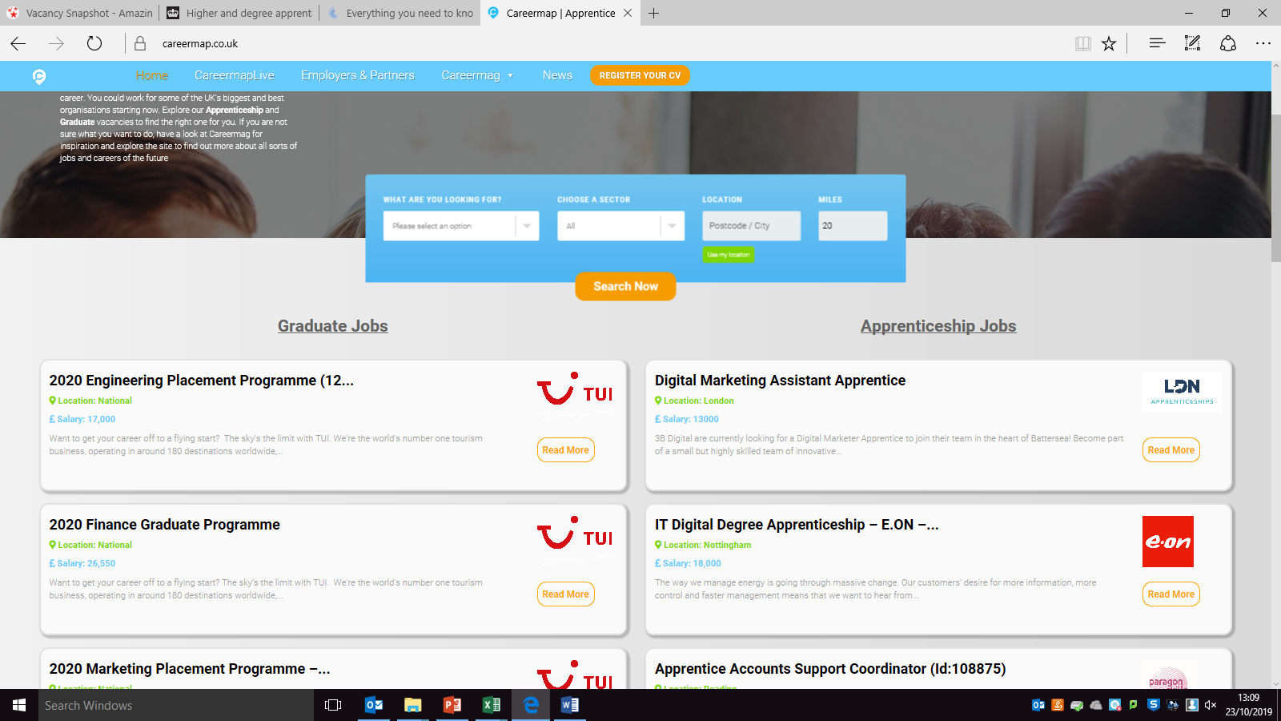
CareerMap
Sign up to get alerts when new vacancies are posted

Slide 10
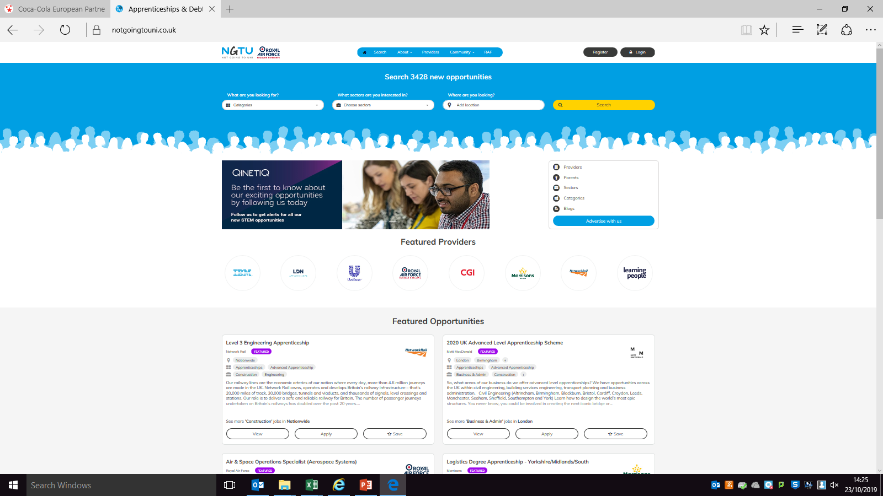
Not Going to Uni

